Slide 1
Intro to CSS & the DOM
CSCI 185, Spring 2023 Intro to Computer Programming for the Web

Slide 2
Announcements
Please review the assigned readings for this week.
Quiz 1 next Friday, 2/10 Study guide and practice quiz have been posted
HW2 due tonight (1/30) at 11:59PM Come to office hours today if you have any last-minute questions!
HW3 posted – due next Monday (2/6) at 11:59PM

Slide 3
Outline
The DOM
Intro to CSS
Selectors
The box model
Specificity and the cascade
Some common properties

Slide 4
Outline
The DOM
Intro to CSS
Selectors
The box model
Specificity and the cascade
Some common properties

Slide 5
Document Object Model (DOM)
(n.) a way of representing a document, like a web page, in a way that can be understood by a human and by a computer. Typically, a DOM is created using HTML. Declarative languages like CSS are used to style it, and programming languages like Javascript allow us to change it.
Notes:
Read Directly from slide…
Obvious, right?

Slide 6
Convert this Simple HTML Page to a DOM Diagram
<html lang="en"> <head> <title>DOM Example</title> <meta name="author" content="EECS 130"> <link rel="stylesheet" href="main.css"> </head> <body> <main> <h1>Hello!</h1> <p>Welcome to this webpage.</p> </main> </body> </html>

Slide 7
HTML Tree Diagram
<html>
<head>
<body>
<title>
<meta>
<link>
<main>
<h1>
<p>
Hello!
Welcome to this webpage.

Slide 8
DOM Schema
HTML
<html lang="en"> <head> <title>DOM Example</title> <meta name="author" content="EECS 130"> <link rel="stylesheet" href="main.css"> </head> <body> <main> <h1>Hello!</h1> <p>Welcome to this webpage.</p> </main> </body> </html>
<html>
<head>
<body>
<title>
<meta>
<link>
<main>
<h1>
<p>
Hello!
Welcome to this webpage.

Slide 9
The DOM (Document Object Model)
A way to manipulate elements and styles on a web page using CSS and JavaScript
Open your console and type:
> document

Slide 10
Outline
The DOM
Intro to CSS
Selectors
The box model
Specificity and the cascade
Some common properties

Slide 11

But how do you make stuff look nice?

Slide 12
CSS Files: Style & Layout
Controls the page style & layout
Stylesheets can either be internal (within style tags) or external (in a separate *.css file)
You can include as many stylesheets as you want!

Slide 13
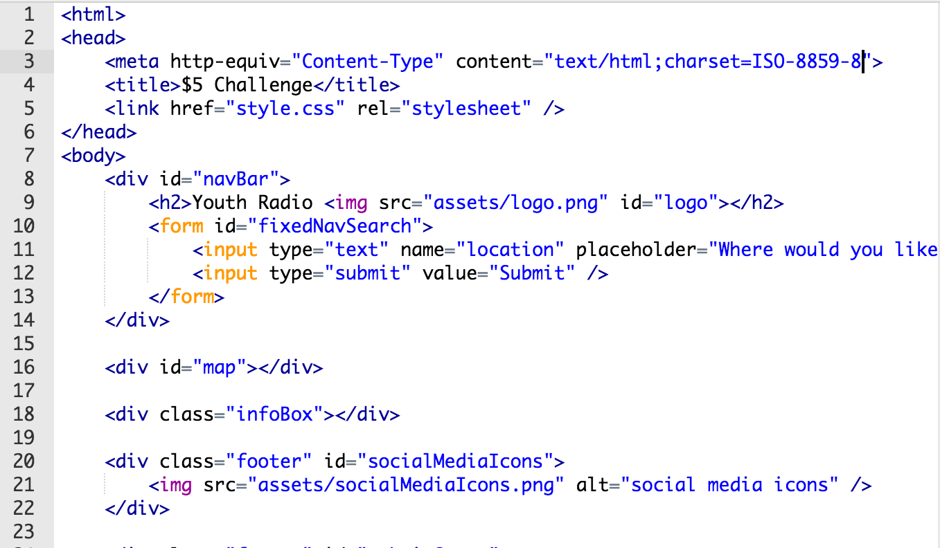
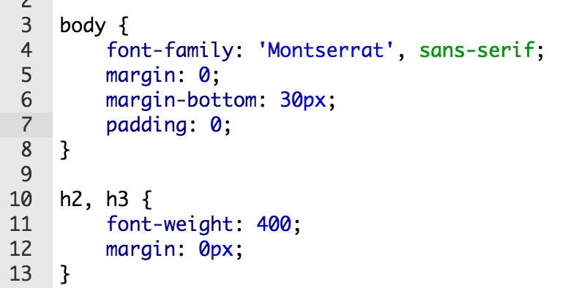
How to include a stylesheet in your HTML
External stylesheets are stored in a separate *.css

Slide 14
Anatomy of a Stylesheet
body {
color: black;
padding: 1em;
}
.title-bar {
padding: 5px;
font-weight: bold;
}
#profile {
background-color: #ddd;
}
Stylesheets are comprised of rulesets

Slide 15
Anatomy of a Ruleset
body {
color: black;
padding: 1em;
}
selector
property
value
declaration

Slide 16
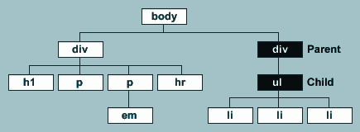
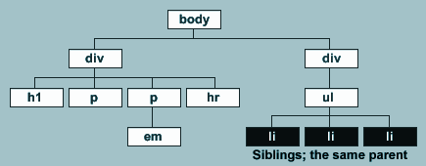
Relationships
1 <html>
2 <head><title>Hello!</title></head>
3 <body>
4 <div>
5 <h1>Left</h1>
6 <p>hi!</p>
7 <p><em>hello</em></p>
8 <hr>
9 </div>
10 <div>Right
11 <ul>
12 <li>list item 1</li>
13 <li>list item 2</li>
14 <li>list item 3</li>
15 </ul>
16 </div>
17 </body> 18 </html>
Parent & Child
Siblings

Slide 17
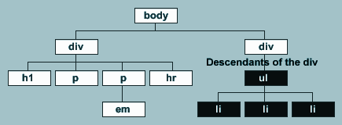
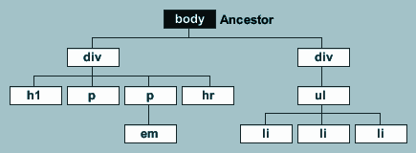
Relationships
1 <html>
2 <head><title>Hello!</title></head>
3 <body>
4 <div>
5 <h1>Left</h1>
6 <p>hi!</p>
7 <p><em>hello</em></p>
8 <hr>
9 </div>
10 <div>Right
11 <ul>
12 <li>list item 1</li>
13 <li>list item 2</li>
14 <li>list item 3</li>
15 </ul>
16 </div>
17 </body> 18 </html>
Descendants
Ancestors

Slide 18
Outline
The DOM
Intro to CSS
Selectors
The box model
Specificity and the cascade
Some common properties

Slide 19
Selectors: Most Important Ones
Selector | Example | Description
.class | .intro | Selects all elements with class=”intro”
#id | #firstname | Selects the element with id=”firstname”
* | * | Selects all elements
element | p | Selects all <p> elements
MEMORIZE THIS SLIDE

Slide 20
Selectors: Also Useful
Selector | Example | Description
element, element | div, p | Selects all <div> elements and all <p> elements
element element | div p | Selects all <p> elements inside <div> elements
element > element | div > p | Selects all <p> elements where the parent is a <div> element
element + element | div + p | Selects all <p> elements that are placed immediately after <div> elements
element~element | p ~ ul | Selects every <ul> element that is preceded by a <p> element

Slide 21
Selectors & Cascades
body {
color: grey;
}
h1, li {
text-transform: uppercase;
display: inline-block;
color: #999999;
}
.title-bar {
padding: 5px;
background-color: #EEEEEE;
}
#profile {
width: 100px;
float: left;
margin-right: 20px;
}
...
1 <body>
2 <div class=”title-bar”>
3 <h1>Welcome, Malik</h1>
4 <img id=”profile” src=”images/pic.png” />
5 <hr>
6 </div>
7 <div>Right
8 <ul>
9 <li>list item 1</li>
10 <li>list item 2</li>
11 <li>list item 3</li>
12 </ul>
13 </div>
14 </body>
...

Slide 22
More Selectors & Cascades
div p {
color: red;
}
div > p {
color: red;
}
.title-bar p {
color: red;
}
...
1 <body>
2 <div class=”title-bar”>
3 <h1>Welcome, Malik</h1>
4 <section>
5 <p>text text text</p>
6 </section>
7 <p>123 456 789</p>
8 </div>
9 <p>blah blah blah</p>
10 <div>Right
11 <p>abc def ghi jkl</p>
12 </div>
13 </body>
...

Slide 23
More On Selectors Here…
https://csci-185.github.io/spring2023/css-reference/selectors/

Slide 24
1. Which are the selectors?
h1 {
color: blue;
margin-top: 1em;
}
.title-bar {
padding: 5px;
font-weight: bold;
}
#profile {
background-color: #ddd;
}

Slide 25
3. Name three properties
h1 {
color: blue;
margin-top: 1em;
}
.title-bar {
padding: 5px;
font-weight: bold;
}
#profile {
background-color: #ddd;
}

Slide 26
4. What will this rule set do to the HTML?
img {
width: 200px;
}
...
1 <body>
2 <div class=”nav-bar”>
3 <h1>Welcome, Malik</h1>
4 <section>
5 <p>text text text</p>
6 </section>
7 <img src=”pic1.png” />
8 <span>123 456 789</span>
9 </div>
10 <img src=”pic2.png” />
11 <p>blah blah blah</p>
12 <div>
13 <p>abc def ghi jkl</p>
14 </div>
...
https://codepen.io/vanwars/pen/LYdvXra

Slide 27
5. What will these rule sets do to the HTML?
body {
text-transform: uppercase;
}
div img {
border: solid 2px #F00;
}
...
1 <body>
2 <div class=”nav-bar”>
3 <h1>Welcome, Malik</h1>
4 <section>
5 <p>text text text</p>
6 </section>
7 <img src=”pic1.png” />
8 <span>123 456 789</span>
9 </div>
10 <img src=”pic2.png” />
11 <p>blah blah blah</p>
12 <div>
13 <p>abc def ghi jkl</p>
14 </div>
...

Slide 28
6. What will this rule set do to the HTML?
* {
color: red;
text-transform: uppercase;
}
...
1 <body>
2 <div class=”nav-bar”>
3 <h1>Welcome, Malik</h1>
4 <section>
5 <p>text text text</p>
6 </section>
7 <img src=”pic1.png” />
8 <span>123 456 789</span>
9 </div>
10 <img src=”pic2.png” />
11 <p>blah blah blah</p>
12 <div>
13 <p>abc def ghi jkl</p>
14 </div>
15 <button>Click me</button>
...

Slide 29
7. What will this rule set do to the HTML?
h1, span {
color: red;
text-transform: uppercase;
}
...
1 <body>
2 <div class=”nav-bar”>
3 <h1>Welcome, Malik</h1>
4 <section>
5 <p>text text text</p>
6 </section>
7 <img src=”pic1.png” />
8 <span>123 456 789</span>
9 </div>
10 <img src=”pic2.png” />
11 <p>blah blah blah</p>
12 <div>
13 <p>abc def ghi jkl</p>
14 </div>
15 <button>Click me</button>
...

Slide 30
Outline
The DOM
Intro to CSS
Selectors
The box model
Specificity and the cascade
Some common properties

Slide 31
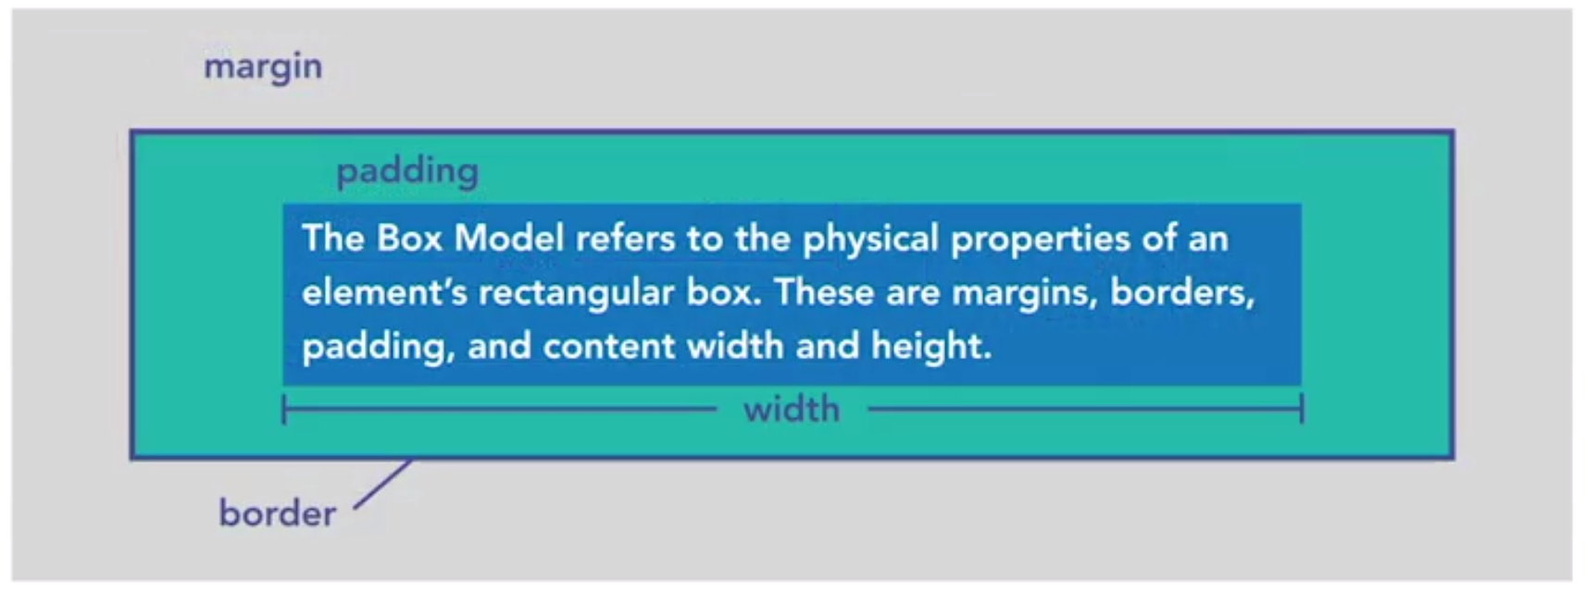
The Box Model
References:
W3 Schools

Slide 32
The Box Model
margin
padding
border
width
box-sizing (border-box v. content box)
display (block, inline-block, flex, grid, etc.). Anything but “inline”
https://codepen.io/vanwars/pen/WWRqRY?editors=0100

Slide 33
Block-Level Elements
HTML tags that have a default display of: display: block;
<address> <article> <aside> <blockquote> <canvas> <dd> <div> <dl> <dt> <fieldset> <figcaption> <figure> <footer> <form> <h1>-<h6> <header> <hr> <li> <main> <nav> <noscript> <ol> <p> <pre> <section> <table> <tfoot> <ul> <video>
https://codepen.io/vanwars/pen/WWRqRY?editors=0100

Slide 34
Inline Elements
HTML tags that have a default display of: display: inline;
<a> <abbr> <acronym> <b> <bdo> <big> <br> <button> <cite> <code> <dfn> <em> <i> <img> <input> <kbd> <label> <map> <object> <output> <q> <samp> <script> <select> <small> <span> <strong> <sub> <sup> <textarea> <time> <tt> <var>
https://codepen.io/vanwars/pen/WWRqRY?editors=0100

Slide 35
Outline
The DOM
Intro to CSS
Selectors
The box model
Specificity and the cascade
Some common properties

Slide 36
Specificity and the Cascade
The “cascade” refers to the way that CSS styles are applied to HTML elements. Styles applied to elements cascade down to their descendants, unless they are overridden.
Specificity is the means by which browsers decide which CSS property values are the most relevant to an element and, therefore, will be applied.
You can think of the cascade as a layering of styling rules, in order of specificity.

Slide 37
Specificity and the Cascade
More specific style declarations take precedence over more “distant” ones:
If one rule is more specific than another one, the more specific rule wins.
If two rules share the same specificity, then then the more “recent” rule takes precedence.
Note: Some properties are not inherited (because it wouldn’t make sense if they did). A table of properties that are / are not inherited can be found at the W3C specification site.

Slide 38
Outline
The DOM
Intro to CSS
Selectors
The box model
Specificity and the cascade
Some common properties

Slide 39
Common CSS Properties and Techniques
Fonts
Color
Box Model (border, margin, padding, width, height)
pseudo-classes (:hover, :active, :visited, etc.)

Slide 40
Activity

